Slide 1

Big Pharma and the World
10/19/2019
James Pelham,
Viktoriya Smith
LeRoy Yeo

Slide 2
Executive Summary
Pharmaceutical industry being so lucrative and attractive profit margins of the companies are extremely attractive to investors. Our team is interested to see if there is a correlation in between Wikipedia top revenue listing companies and Yahoo 52-week stock index prices. We would like to present this information to forecast relationships for the future stock prices. The industry we chose for this analyst, which is one of the major revenue producers, is the pharmaceutical industry. We will look at its performance in calendar year 2018. For the purposes of our analysis we took three (3) separate datasets: two (2) from Wikipedia and one (1) from Yahoo Finance. We analyzed top 27 revenue producers and top 34 companies by market capitalization to come up with top 53 true industry leaders. Final analysis included top five (5) companies.

Slide 3
Data Sources
Wikipedia
Yahoo Finance

Slide 4

Data Gathering & Cleaning
The following Steps were made to obtain and clean the data:
Create a function to find null values per columns and rows.
Drop columns with greater than 80% null values.
Drop columns we don’t need for future analysis.
Check dtypes; make sure they are all correct and uniform.
Use regex to clean and normalize data.
Rename columns – remove any unwanted syntax.
Set index.

Slide 5

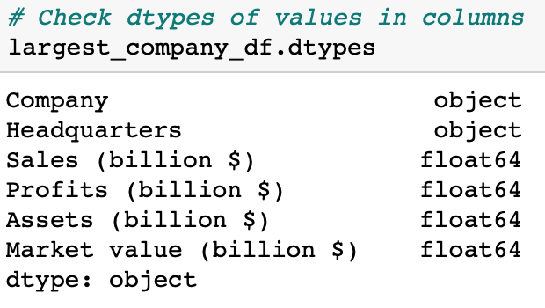
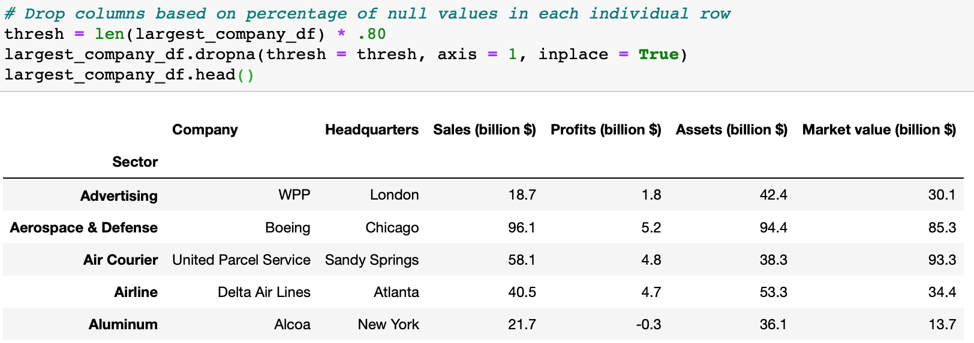
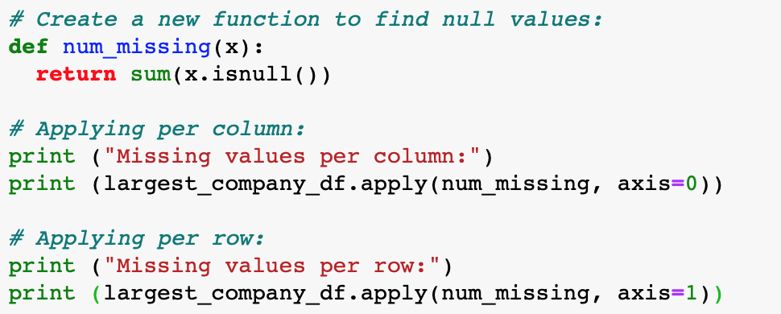
Data Gathering and Cleaning
4
2
1
3

Slide 6
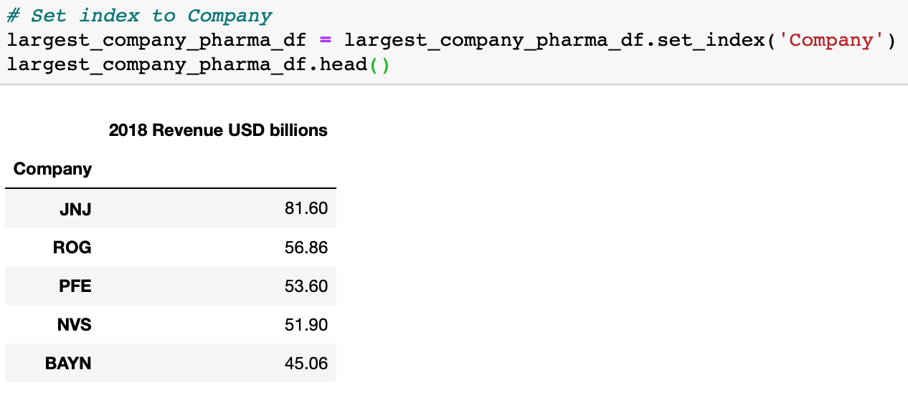
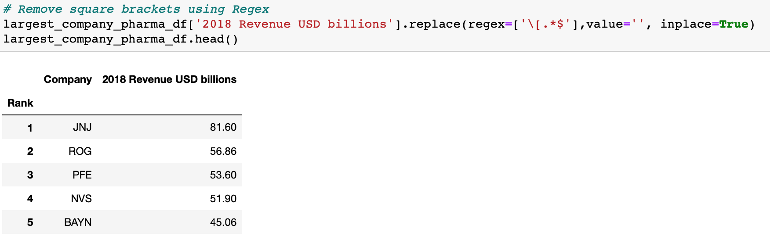
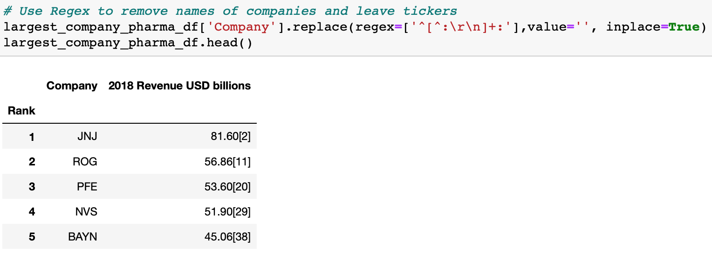
Data Gathering and Cleaning
7
5
5
6

Slide 7
Data Dictionary
Field Name | Type | Definition | Example
Ticker | VARCHAR | A ticker symbol is an arrangement of characters—usually letters—representing securities listed on an exchange or otherwise traded publicly. | NVO, ILMN
Revenue | Numeric | Reported financial income of the organization for the year under analysis | 22.09
Year | date | Whole calendar or fiscal year for which the company financial numbers are being reported | 2018
Pharma_rank | int | Ranking of the companies presented for analysis based on the yearly revenue numbers | 1,2,3, etc.
Market cap | Numeric | The value of a company that is traded on the stock market, calculated by multiplying the total number of shares by the present share price. | 346.1
Pharma_rank | int | Ranking of the companies presented for analysis based on the yearly company valuation numbers | 1,2,3, etc.
adj_close | Numeric | The stock closing price that factors in anything that might affect the stock price after the market closes. | 69.81
high | Numeric | Day's high is the highest price at which a stock traded during the trading day. | 359.61
low | Numeric | Today's low is the lowest price at which a stock trades over the course of a trading day. | 35.5
volume | Numeric | It is a measure of the total turnover of shares. Counted as the total number of shares that are traded (bought and sold) during the trading day or specified set period of time. | 11417200
open | Numeric | The opening price is the price at which a security first trades upon the opening of an exchange on a trading day. | 18.76
close | Numeric | Close or closing price generally refers to the last price at which a stock trades during a regular trading session without inclusion of any factors affecting the stock price after the trading is closed for the day. | 176.41

Slide 8
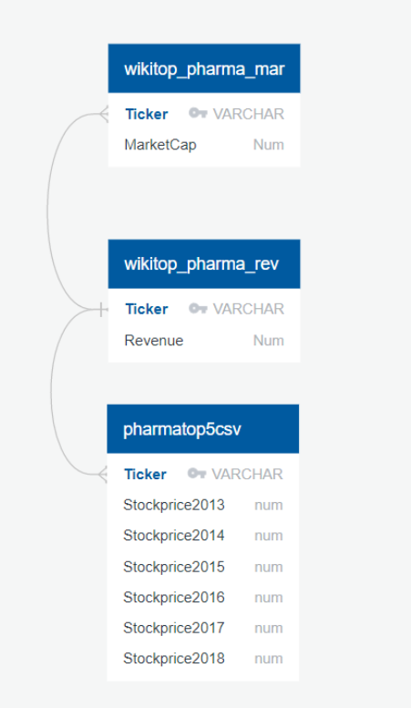
Relationships (ERD) Diagram

Slide 9
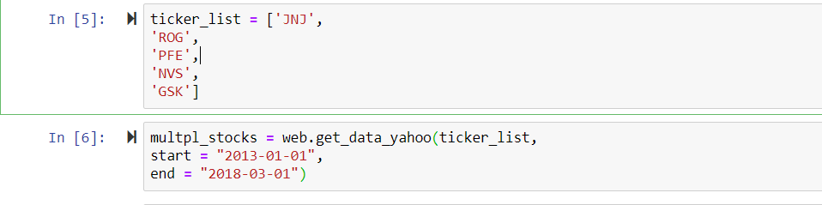
Narrowing down to top five

Slide 10
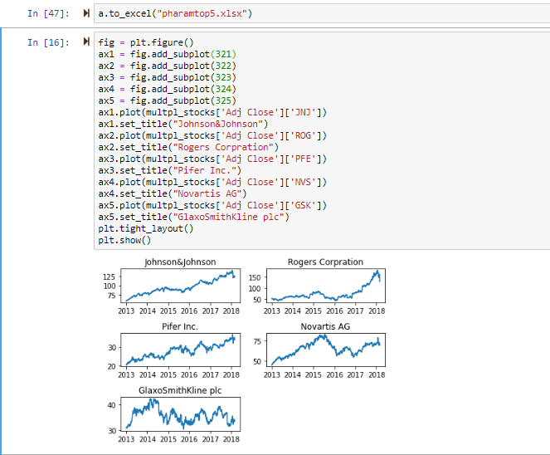
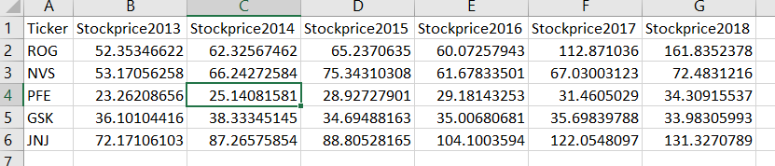
Plotting into graphs by year

Slide 11
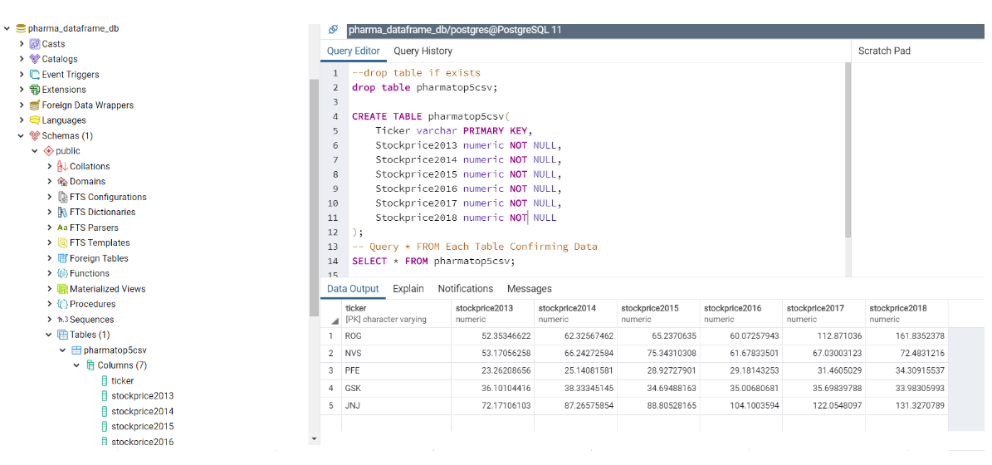
Postgresql

Slide 12
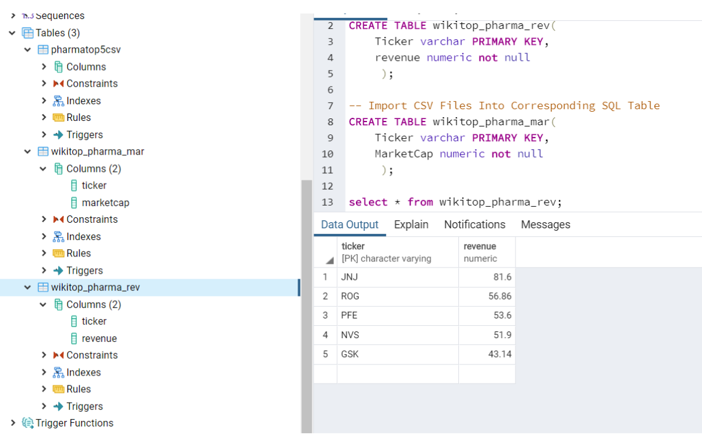
Postgresql (cont.)

Slide 13
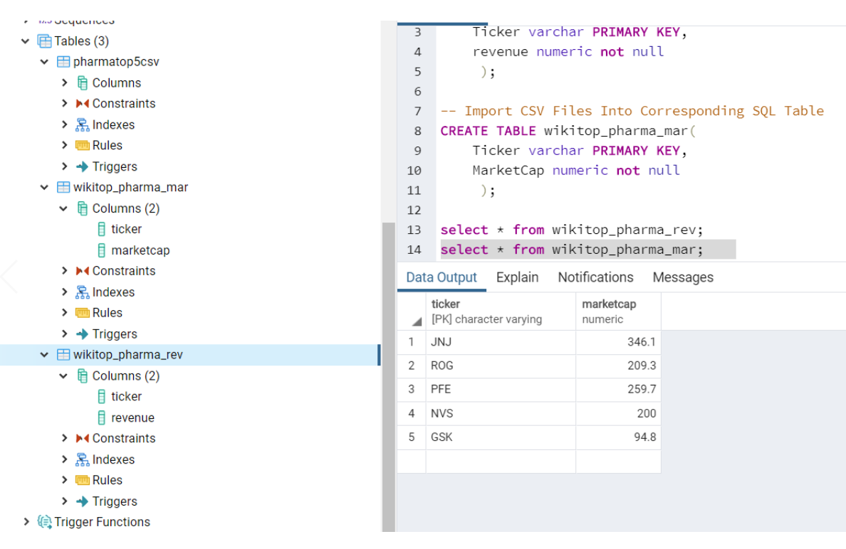
Postgresql (cont.)

Slide 14
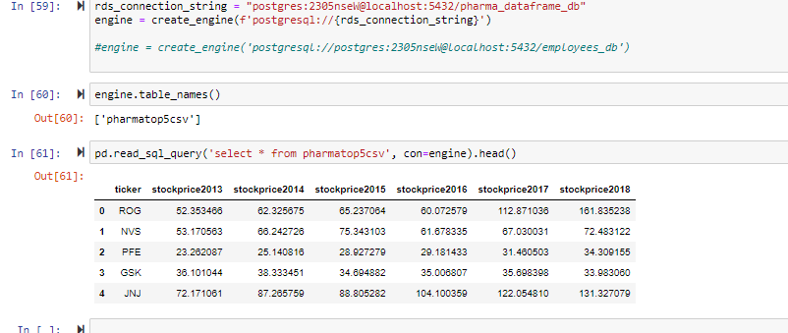
SQL Alchemy

